Slide 1

MIS 281N
Data Management
Class 7 – Wrap-up Security + Issues with Relational DBs
Clint Tuttle
Senior Lecturer, The University of Texas at Austin
Brad Poynter
Lecturer, The University of Texas at Austin

Slide 2
AGENDA
Historical context the RDBMS
What issues exist for the RDBMS
How does the RDBMS compare to NoSQL

Slide 3
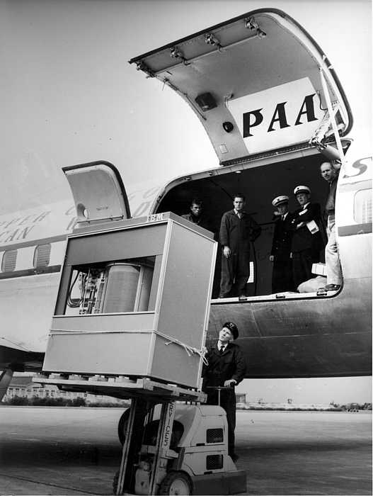
Why did we create the rdbms?
The RDBMS was invented in the 1970s when storage was expensive
IBM’s digital drive (Held 5MB & cost 6 figures)
Most companies leased storage then since they couldn’t afford to own it (Whaaa? Is this an early version of cloud? ☺)
1980 – 2.5GB = $81,000
1992 – 1GB = $1000
Today it’s pennies
So in 1970 storage was most expensive resource
Reducing redundancy matters with a 5MB harddrive
Concept of normalization is created
Relational DBs use joins to create a denormalized view
Joins increase the CPU cost on your system
Highest cost in data center today isn’t storage, but CPU
NoSQL is faster or more scalable…why?
Scales horizontally which Relational wasn’t concerned about before big data came along
Stores in a denormalized manner, no joins (better on CPU)
https://www.pingdom.com/blog/amazing-facts-and-figures-about-the-evolution-of-hard-disk-drives/

Slide 4
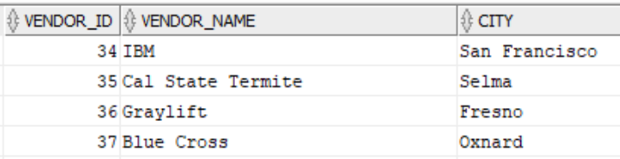
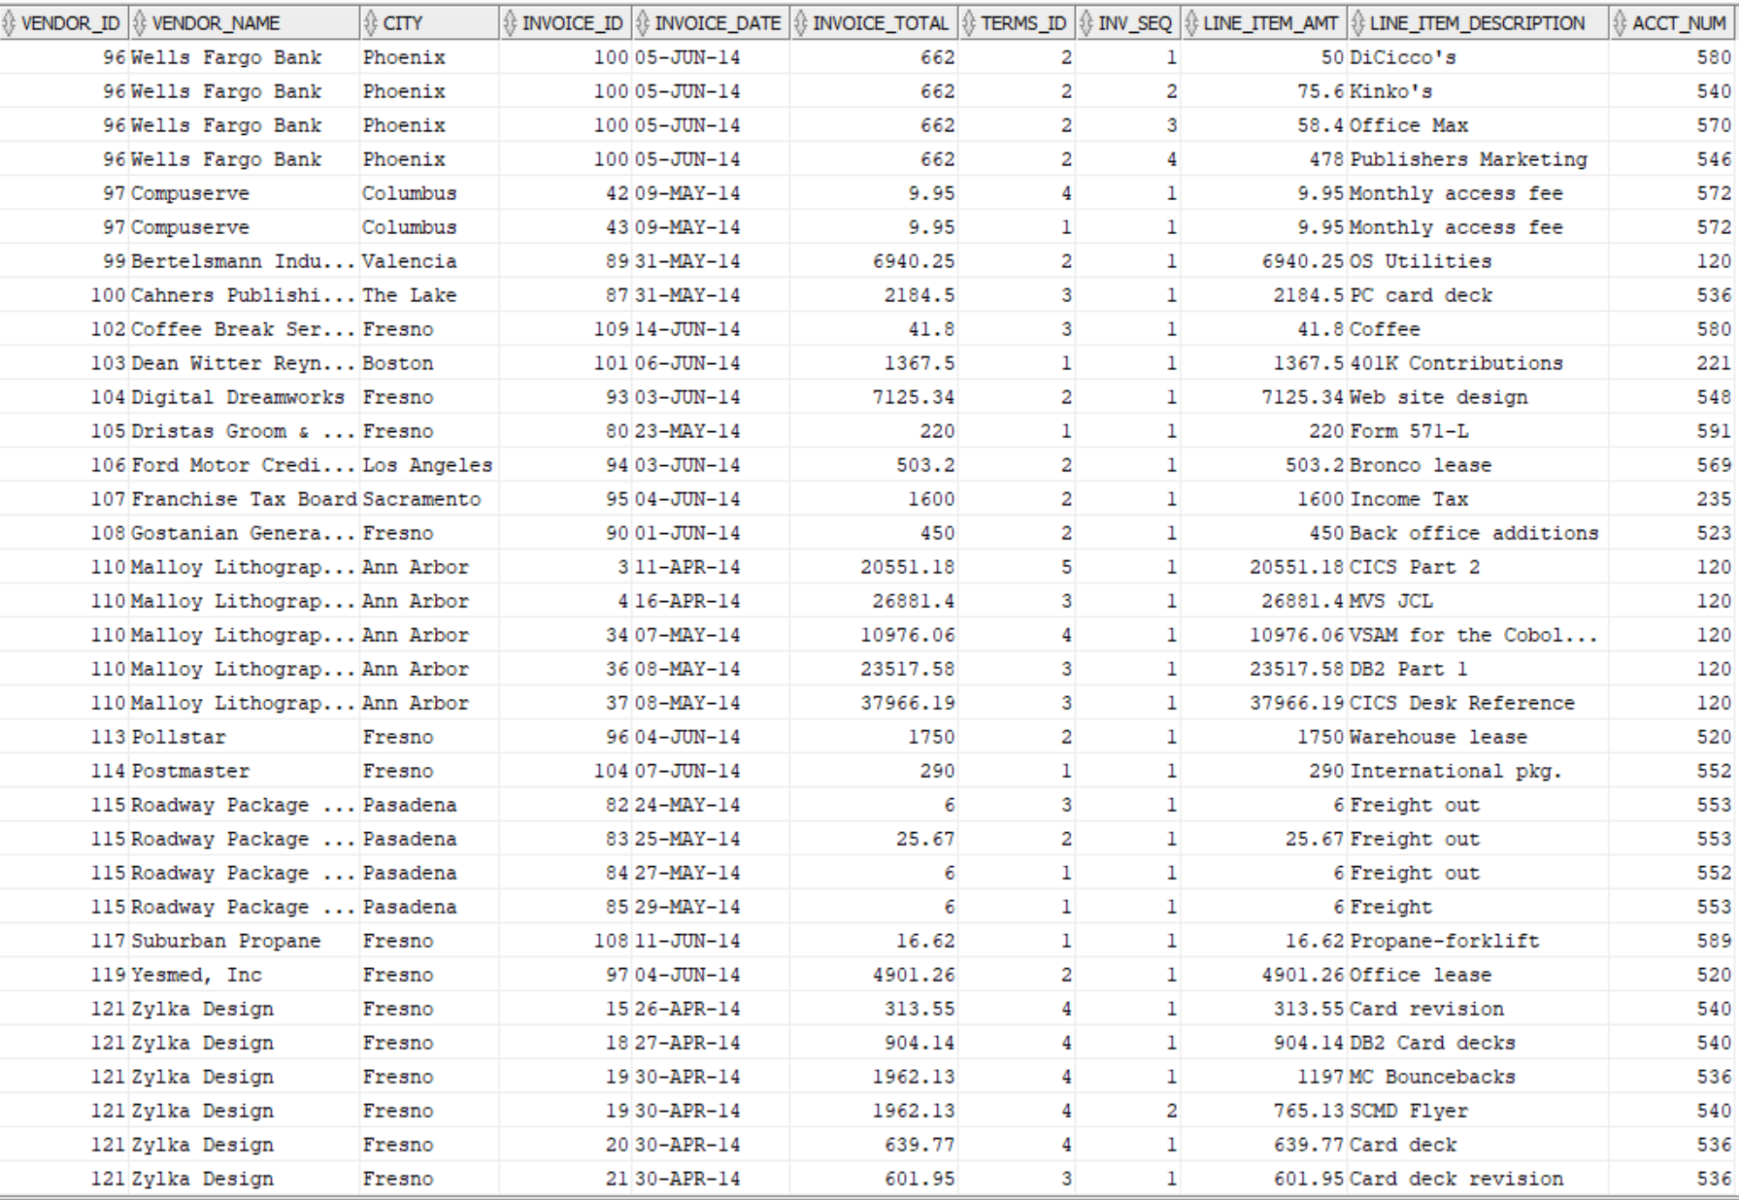
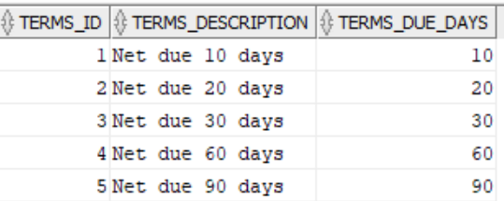
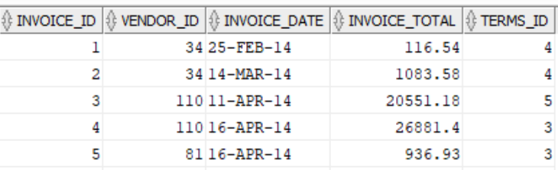
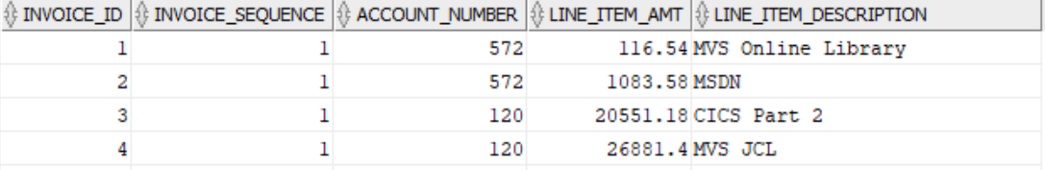
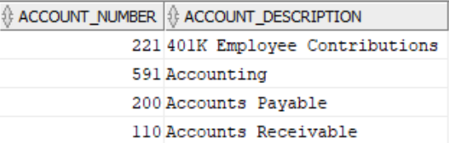
Normalized vs Denormalized
Vendors
Accounts_Payable (Vendors, Invoices, Terms, Ledger_Accounts)
Terms
Invoice
Invoice_Line_Items
General_Ledger_Accounts

Slide 5
Relational Databases are an incredible commercial success
Simple & Powerful Model
Standardization
High Performance & Secure
Innovation

Slide 6
Relational Databases are an incredible commercial success
Intuitive and elegant entity-relationship model
Ability to represent complex, real-world business scenarios
Ability to generalize into software products and customize for specific industries and businesses
Simple & Powerful Model
Standardization
High Performance & Secure
Innovation

Slide 7
Relational Databases are an incredible commercial success
Simple & Powerful Model
SQL is for the most part standard and portable
Standardization
High Performance & Secure
Innovation

Slide 8
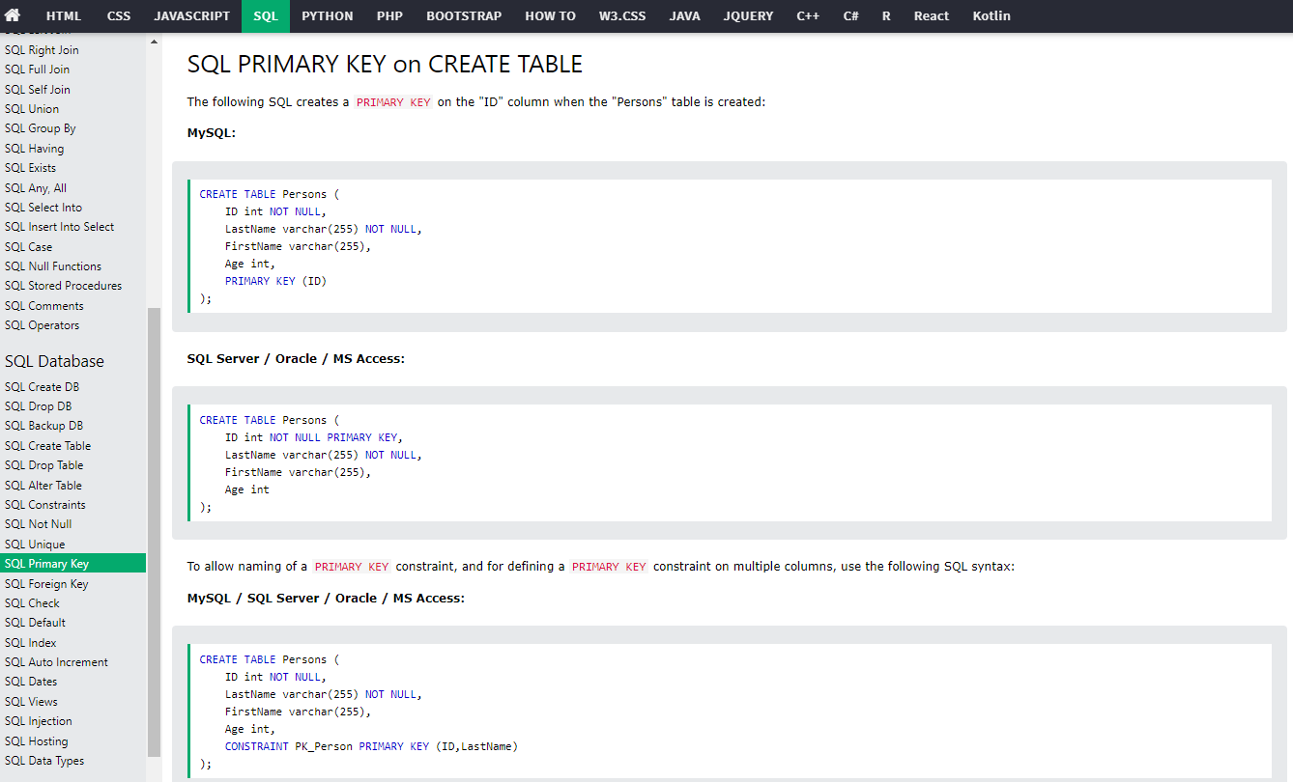

Slide 9
Relational Databases are an incredible commercial success
Simple & Powerful Model
SQL is for the most part standard and portable
SQL can be used by people with “moderately” technical skills
Integration of SQL with programming languages
Robust commercial offerings (Oracle, Microsoft SQL Server, IBM DB2)
Robust open-source offerings (MySQL, PostgreSQL)
Standardization
High Performance & Secure
Innovation

Slide 10
Relational Databases are an incredible commercial success
Simple & Powerful Model
Standardization
Feature rich security models (authentication, authorization, role/content-based access controls, encryption …)
Optimized physical implementations for large data volumes (partitioning, indexing, …) and thousands of concurrent users
ACID – Atomic, Consistent, Isolation, and Durable
Entrenched/Ubiquitous – i.e. Widely deployed business applications
High Performance & Secure
Innovation
Notes:
ACID – Atomicity, Consistency, Isolation and Durability

Slide 11
Relational Databases are an incredible commercial success
Simple & Powerful Model
Standardization
High Performance & Secure
Research by industry and academia continues
Continuous innovation for the last 50 years
Consolidation has not prevented a competitive market
Innovation

Slide 12


RDBMS an incredible commercial success through all trends
Simple & Powerful Model
Users
UI /
Client
Client-server architecture
Internet/Web
Cloud/SaaS
Blockchain
…
Standardization
High Performance & Secure
App
Servers
Innovation
Databases

Slide 13
What happened to reveal issues with the RDBMS
The market is changing at faster pace today than 70s
Changing RDBMS data model is complex
Business Analytics has different needs
Enterprise Data is siloed in many databases
Data evolved: Multimedia, OO, Graphs, Automation
RDBMS wasn’t built to handle these
Big Data
3..4…5Vs…6V??
Scaling an RDBMS is costly
Notes:
Volume: the size and amounts of big data that companies manage and analyze
Value: the most important “V” from the perspective of the business, the value of big data usually comes from insight discovery and pattern recognition that lead to more effective operations, stronger customer relationships and other clear and quantifiable business benefits
Variety: the diversity and range of different data types, including unstructured data, semi-structured data and raw data
Velocity: the speed at which companies receive, store and manage data – e.g., the specific number of social media posts or search queries received within a day, hour or other unit of time
Veracity: the “truth” or accuracy of data and information assets, which often determines executive-level confidence
The additional characteristic of variability can also be considered:
AND NOW?
Variability: the changing nature of the data companies seek to capture, manage and analyze – e.g., in sentiment or text analytics, changes in the meaning of key words or phrases
https://www.teradata.com/Glossary/What-are-the-5-V-s-of-Big-Data#:~:text=Big%20data%20is%20a%20collection,variety%2C%20velocity%2C%20and%20veracity

Slide 14
What happened to reveal issues with the RDBMS
Changing RDBMS data model is complex
Enterprise Data is siloed in many databases
RDBMS wasn’t built to handle these
Scaling an RDBMS is costly
Notes:
Volume: the size and amounts of big data that companies manage and analyze
Value: the most important “V” from the perspective of the business, the value of big data usually comes from insight discovery and pattern recognition that lead to more effective operations, stronger customer relationships and other clear and quantifiable business benefits
Variety: the diversity and range of different data types, including unstructured data, semi-structured data and raw data
Velocity: the speed at which companies receive, store and manage data – e.g., the specific number of social media posts or search queries received within a day, hour or other unit of time
Veracity: the “truth” or accuracy of data and information assets, which often determines executive-level confidence
The additional characteristic of variability can also be considered:
AND NOW?
Variability: the changing nature of the data companies seek to capture, manage and analyze – e.g., in sentiment or text analytics, changes in the meaning of key words or phrases
https://www.teradata.com/Glossary/What-are-the-5-V-s-of-Big-Data#:~:text=Big%20data%20is%20a%20collection,variety%2C%20velocity%2C%20and%20veracity

Slide 15
However, there are several issues with Relational databases
Changing an in-use data model is difficult, time-consuming, and expensive
Changing RDBMS data model is complex
Enterprise Data is siloed in many databases
RDBMS wasn’t built to handle these
Scaling an RDBMS is costly

Slide 16
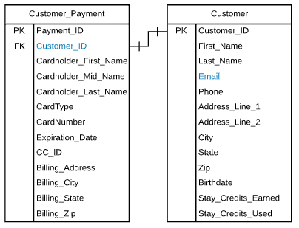

Hypo: Customer can only have one secured payment.
What if we wanted to change that to 1-m?
ALTER TABLE customer_payment
DROP CONSTRAINT unique_customer_id;

Slide 17
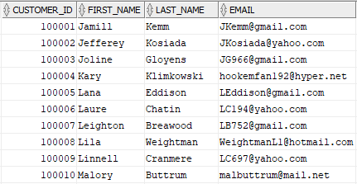
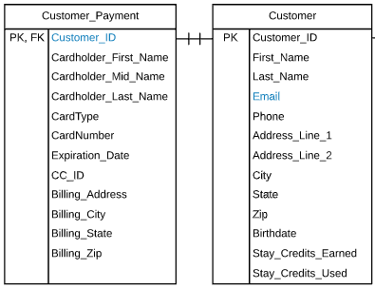
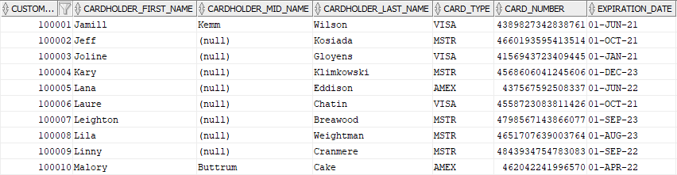
Hypo: What if we want to allow customers to have many credit cards?

Slide 18
However, there are several issues with Relational databases
Changing an in-use data model is difficult, time-consuming, and expensive
Maintenance of database code such as stored procedures is complex
Diagnosing performance changes in a database is complex
Maintaining user roles and privileges requires elevated skillset (i.e. matrix)
Changing RDBMS data model is complex
Enterprise Data is siloed in many databases
RDBMS wasn’t built to handle these
Scaling an RDBMS is costly

Slide 19
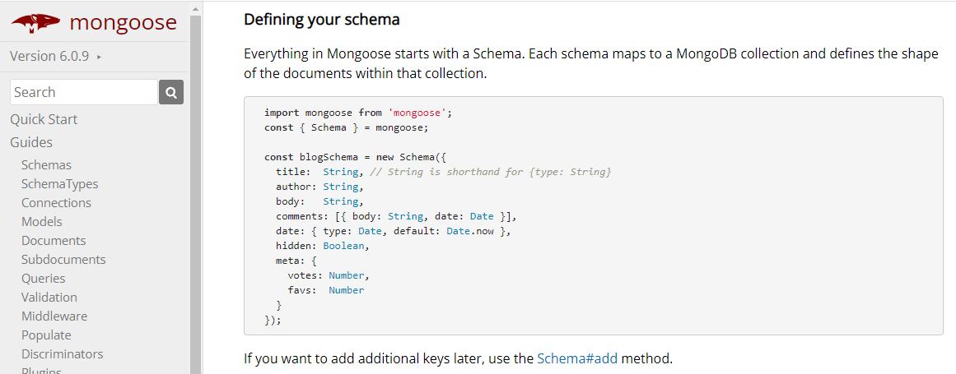
Even in NoSQL a schema is nice

Slide 20
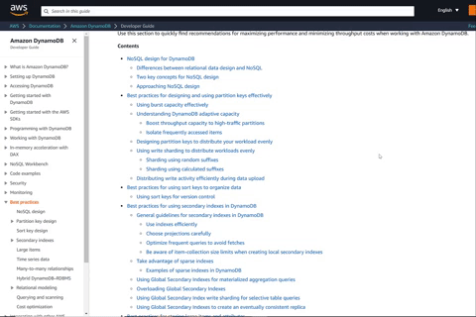
Data is relational…
…so the ERD still matters even in NoSQL
But the way we you implement the model into a schema is hard
RDBMS was not deprecated by NoSQL
Schema-less is useful when data model is constantly evolving + scale matters
Question: Do you design fast (with RDB), hoping scale won’t matter or do you take the harder/slower design approach hoping you’ll need to scale?

Slide 21
However, there are several issues with Relational databases
Changing RDBMS data model is complex
Data needed for analytics is distributed across multiple databases
Often data from these multiple databases cannot be combined easily
Lack of uniform naming standards or definitions of data across multiple DBs
Many advanced analytical tools are not integrated well with the DBMS
Enterprise Data is siloed in many databases
RDBMS wasn’t built to handle these
Scaling an RDBMS is costly

Slide 22
However, there are several issues with Relational databases
Changing RDBMS data model is complex
Enterprise Data is siloed in many databases
Limited datatypes (string, int, date) originally. Didn’t handle multi-media and geo
Entities artificially separate “data” from “behavior”
Unique scenarios such as graphs (e.g. social networks) difficult to model
Automation was originally built into databases originally
RDBMS wasn’t built to handle these
Scaling an RDBMS is costly

Slide 23
However, there are several issues with Relational databases
Changing RDBMS data model is complex
Enterprise Data is siloed in many databases
RDBMS wasn’t built to handle these
Commercial DB products are expensive with increasing costs
Highly skilled labor required for maintenance
Expensive hardware infrastructure needed for high/peak performance
Scaling an RDBMS is costly

Slide 24
Specialized solutions have been developed over the past 50+ years to address the limitations of relational database management systems
Changing RDBMS data model is complex
Enterprise Data is siloed in many databases
What are potential solutions to the issues with relational databases?
RDBMS wasn’t built to handle these
Scaling an RDBMS is costly

Slide 25
Possible Solutions to RDBMS issues
Changing RDBMS data model is complex
NoSQL → Schema-less databases
Key-value, columnar, document store
Enterprise Data is siloed in many databases
Data warehousing
(ROLAP) Relational Online Analytical Processing
RDBMS wasn’t built to handle these
Multimedia DBs → unstructured datastores → Lakes
Object-oriented DBs
Graph DBs (social networks), Active DBs (automation)
Scaling an RDBMS is costly
Cluster computing + NoSQL + Cloud computing

Slide 26
Questions

Slide 27
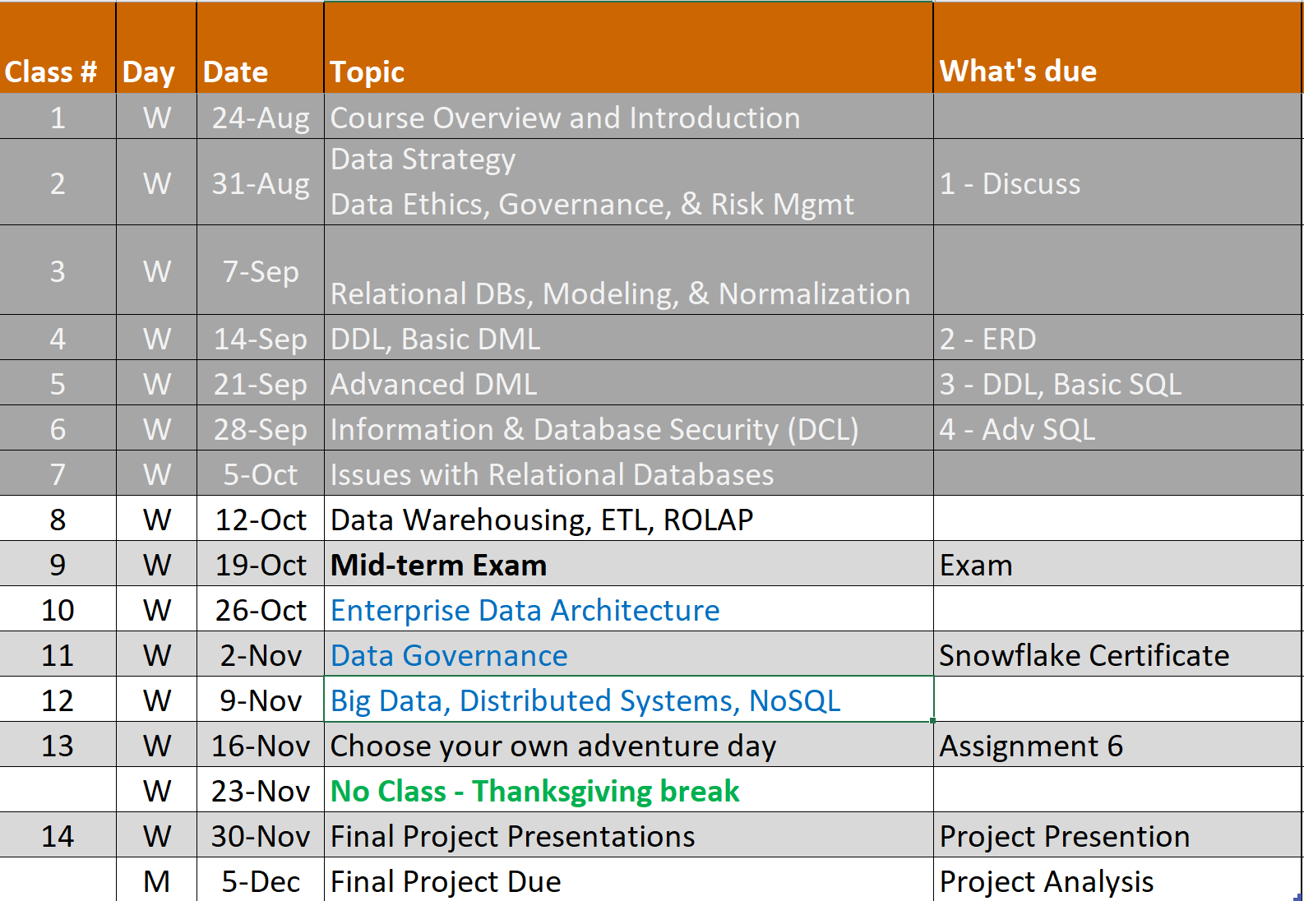
Looking Back

Slide 28
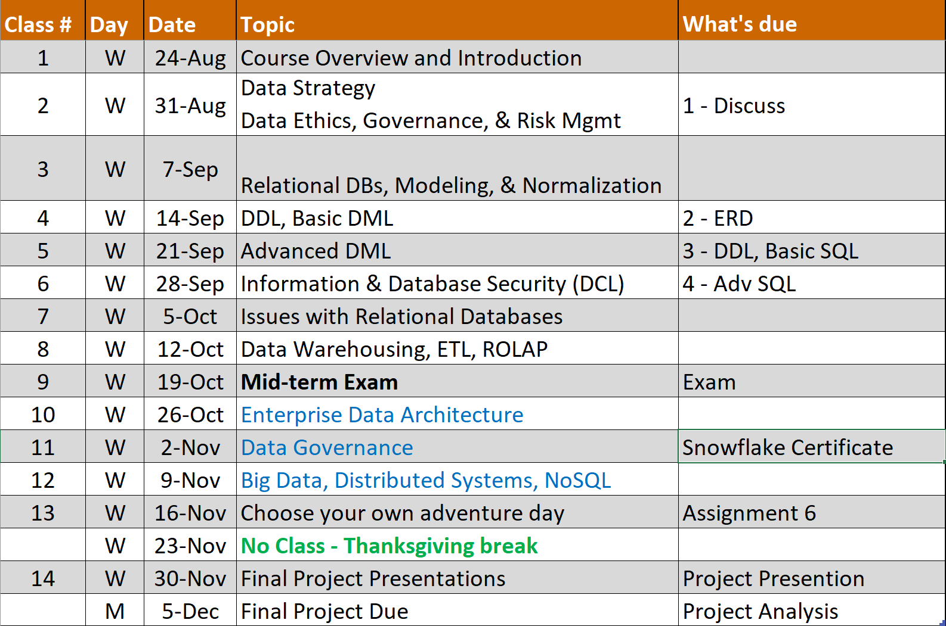
Looking ahead

Slide 29
Snowflake Cert
Assignment instructions are posted on Canvas and you can start when you are ready.
It’s about 4-8 hours of work to complete it
Due on Nov 2nd so you have a month
NOTE: You can earn a badge when you show them proof but for us just submit proof that you complete the course or the badge.
There are 3 more you can do optionally if you like

